Slide 1

Current situation or condition of stock market of Bangladesh
.
A Comprehensive Analysis

Slide 2

Executive Summary
Bangladesh stock market has evolved significantly.
DSEX index rose by 35.08% in early 2025.
Regulatory reforms have improved transparency and stability.
Challenges include speculative trading and low financial literacy.
Opportunities in digital transformation and green finance.

Slide 3
Background and Objectives
Background
Objectives
The stock market serves as a barometer of economic health. The Dhaka Stock Exchange (DSE) and Chittagong Stock Exchange (CSE) have experienced growth, but also historical crashes in 1996 and 2010-2011.
The primary goal is to analyze the current market scenario and investor behavior. Specific objectives include studying past market crashes, understanding investor trends, and examining regulatory aspects.

Slide 4
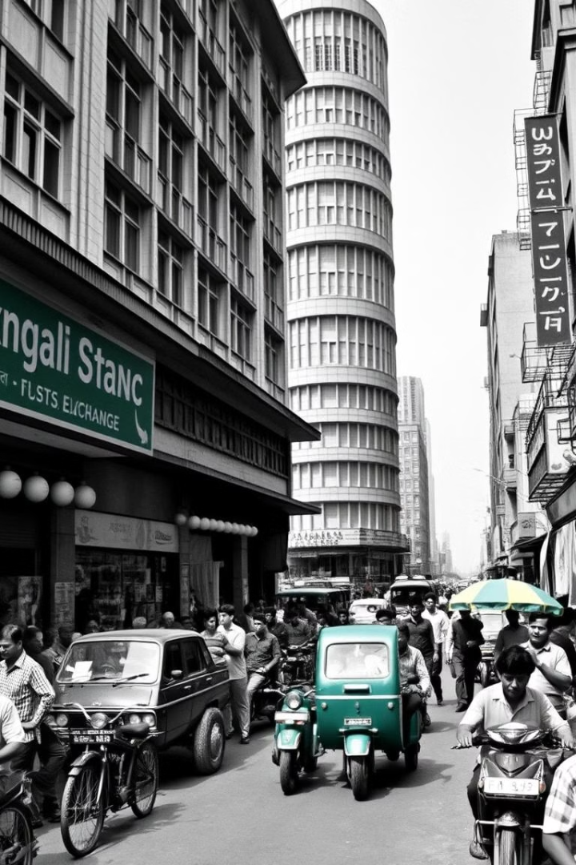
Historical Overview
1
1954
Inception as East Pakistan Stock Exchange.
2
1962
Renamed Dhaka Stock Exchange (DSE).
3
1996 & 2010-2011
Major market crashes.
4
Post-Crashes
Regulatory reforms implemented.

Slide 5
Key Stock Exchanges
Dhaka Stock Exchange (DSE)
Chittagong Stock Exchange (CSE)
Established in 1964, automated trading introduced in 1998. Key indices include DSI, DSEX, and DS30. Functions include listing, trading, settlement, and market surveillance.
Established in 1995, automated trading introduced in 1998. Key indices include CASPI, CSE30, and CSCX. Functions are similar to DSE, providing a platform for trading and investment.

Slide 6
Market Indicators & Sector Performance
Market Indicators
Sector Performance
Key parameters include the number of listed companies, market capitalization, and daily trade volume. Efficiency indicators include P/E ratio, dividend yield, and liquidity.
The DSE has 296 companies with 562 securities, while the CSE has 264 companies with 302 securities. Key sectors include Banking, Insurance, Pharmaceuticals, and Textiles.

Slide 7

Present Market Scenario (2025)
35.08%
$114.5B
DSEX Growth
Market Cap
Index rose significantly.
Projected capitalization.
The DSEX Index rose by 35.08% in early 2025, indicating strong market performance. Market capitalization is projected to reach $114.50 billion by 2025. Technology, Banking, and Consumer Goods sectors are leading growth.

Slide 8

Future Prospects & SWOT Analysis
Prospects
Growth in technology and telecommunications, government focus on debt capital market, potential in securitization, derivatives, and green finance.
SWOT
Strengths include high returns and a regulatory body. Weaknesses include volatility and lack of professional standards. Opportunities include growth in technology and foreign investment.
Notes:
Assalamu-Alikum
I am A.K.M Jubair, My Roll Number is 22 MGT 048.
My presentation part is Future Prospects and SWOT Analysis of Bangladesh Stock market.
Let’s start with the future prospects of the market. Experts believe that by 2025, the market could see a strong recovery if the right policies are implemented. The government is actively working on economic reforms to attract more investors and improve transparency.
Now, let’s take a look at the SWOT analysis—which covers the strengths, weaknesses, opportunities, and threats of the stock market.
The strengths include Bangladesh’s growing economy with a young and energetic workforce. Recent reforms and policy changes have improved market stability, and key sectors like ready-made garments and textiles continue to drive economic growth.
However, there are also weaknesses that hold the market back. Low liquidity is a major issue.
Despite these weaknesses, there are exciting opportunities ahead. With better reforms, both local and foreign investors may show greater interest in the market. The rise of digital trading and AI-powered stock analysis is making it easier for investors to trade and predict market trends.

Slide 9

Findings & Recommendations
Investors are often influenced by rumors and short-term gains. Financial institutions play a significant role in market liquidity. Regulatory bodies need to strengthen surveillance and enforcement to ensure market stability.
Recommendations include demutualization of stock exchanges, strengthening market surveillance systems, ensuring integrity of BSEC staff, introducing asset revaluation policies, and increasing the supply of fundamentally strong securities.
Notes:
[Findings & Recommendations]*"The stock market in Bangladesh faces some challenges. Many investors focus on short-term gains, and rumors affect decisions. Financial institutions help keep the market running, but we need stronger rules and oversight. To improve the market, we suggest: Making stock exchanges independent. Strengthening market monitoring. Ensuring honesty in regulatory staff. Updating asset valuation policies. Increasing strong and reliable stocks.

Slide 10
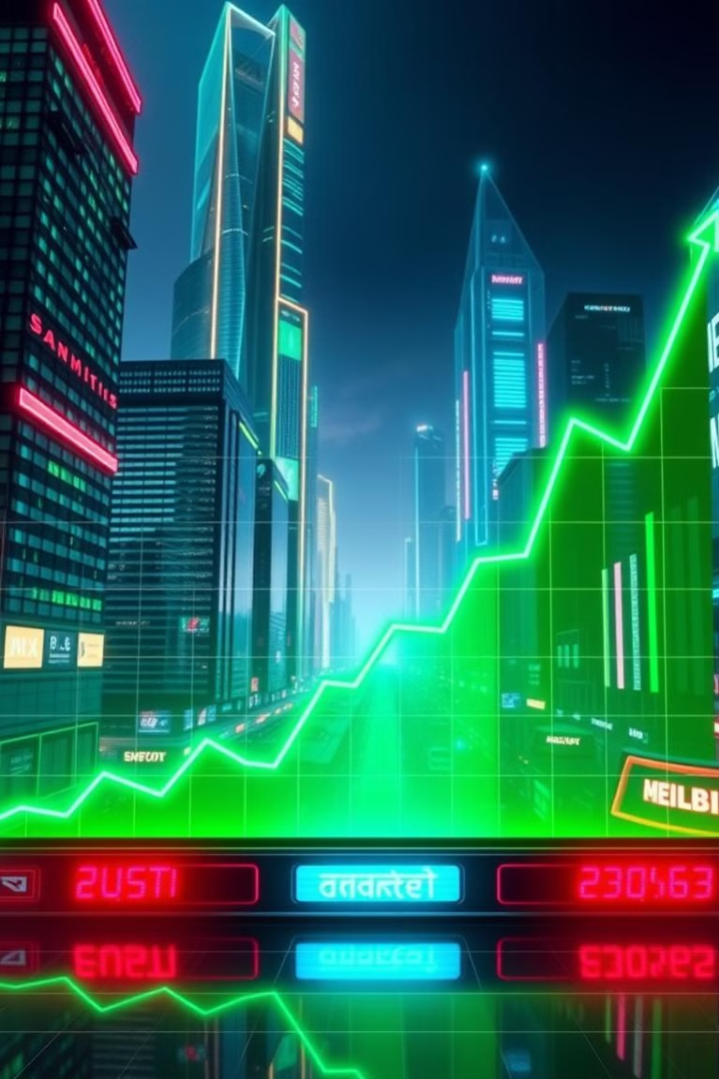
Conclusion
The Bangladesh stock market is poised for significant growth and transformation. By leveraging its economic potential, embracing technological advancements, and continuing regulatory reforms, Bangladesh has the opportunity to build a robust, competitive, and transparent stock market that can attract investment from around the world and support the country’s broader economic development.
Notes:
[Findings & Recommendations]*"The stock market in Bangladesh faces some challenges. Many investors focus on short-term gains, and rumors affect decisions. Financial institutions help keep the market running, but we need stronger rules and oversight. To improve the market, we suggest: Making stock exchanges independent. Strengthening market monitoring. Ensuring honesty in regulatory staff. Updating asset valuation policies. Increasing strong and reliable stocks.

Slide 11
Thank You

